Slide 1

CSE1021- Problem Solving and Programming

Slide 2
Unit-3

Slide 3
Decision Control Statements

Slide 4
Control Statements
A control statement is a statement that determines the control flow of a set of instructions, i.e., it decides the sequence in which the instructions in a program are to be executed.
Types of Control Statements —
Sequential Control: A Python program is executed sequentially from the first line of the program to its last line.
Selection Control: To execute only a selected set of statements.
Iterative Control: To execute a set of statements repeatedly.

Slide 5
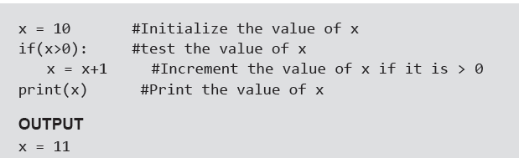
If Statement
Example:

Slide 6
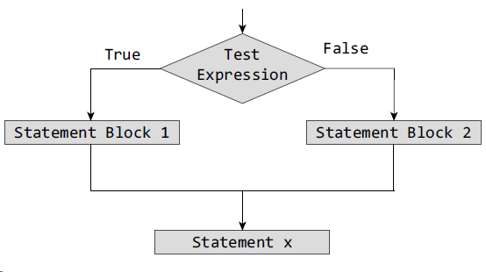
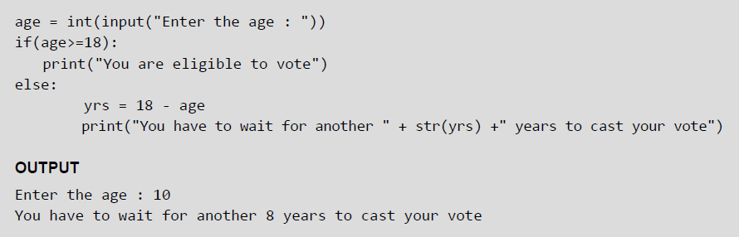
If-Else Statement
Example:

Slide 7
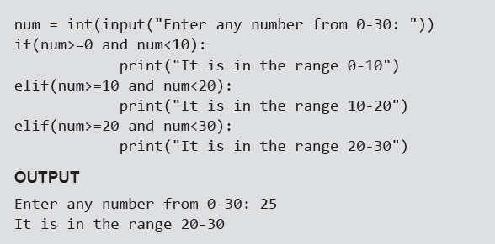
Nested if Statements
A statement that contains other statements is called a compound statement. To perform more complex checks, if statements can be nested, that is, can be placed one inside the other. In such a case, the inner if statement is the statement part of the outer one. Nested if statements are used to check if more than one conditions are satisfied.
Example:

Slide 8
If-elif-else Statement
Python supports if-elif-else statements to test additional conditions apart from the initial test expression. The if-elif-else construct works in the same way as a usual if-else statement. If-elif-else construct is also known as nested-if construct.
Example:

Slide 9
While Loop
Example:

Slide 10
For Loop
For loop provides a mechanism to repeat a task until a particular condition is True. It is usually known as a determinate or definite loop because the programmer knows exactly how many times the loop will repeat.
The for...in statement is a looping statement used in Python to iterate over a sequence of objects.

Slide 11
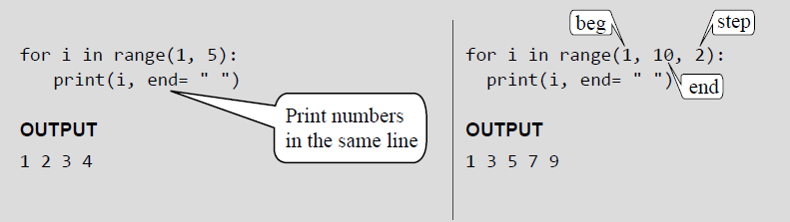
For Loop and Range() Function
The range() function is a built-in function in Python that is used to iterate over a sequence of numbers. The syntax of range() is range(beg, end, [step])
The range() produces a sequence of numbers starting with beg (inclusive) and ending with one less than the number end. The step argument is option (that is why it is placed in brackets). By default, every number in the range is incremented by 1 but we can specify a different increment using step. It can be both negative and positive, but not zero.
Examples:

Slide 12
Range() Function
If range() function is given a single argument, it produces an object with values from 0 to argument-1. For example: range(10) is equal to writing range(0, 10).
• If range() is called with two arguments, it produces values from the first to the second. For example, range(0,10).
• If range() has three arguments then the third argument specifies the interval of the sequence produced. In this case, the third argument must be an integer. For example, range(1,20,3).
Examples:

Slide 13
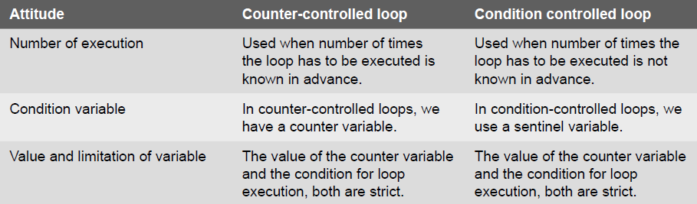
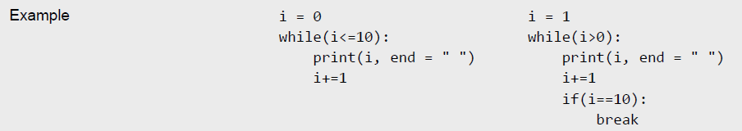
Condition-controlled and Counter-controlled Loops

Slide 14
Nested Loops
Python allows its users to have nested loops, that is, loops that can be placed inside other loops. Although this feature will work with any loop like while loop as well as for loop.
A for loop can be used to control the number of times a particular set of statements will be executed. Another outer loop could be used to control the number of times that a whole loop is repeated.
Loops should be properly indented to identify which statements are contained within each for statement.
Example:

Slide 15
The Break Statement
The break statement is used to terminate the execution of the nearest enclosing loop in which it appears. The break statement is widely used with for loop and while loop. When compiler encounters a break statement, the control passes to the statement that follows the loop in which the break statement appears.
Example:

Slide 16
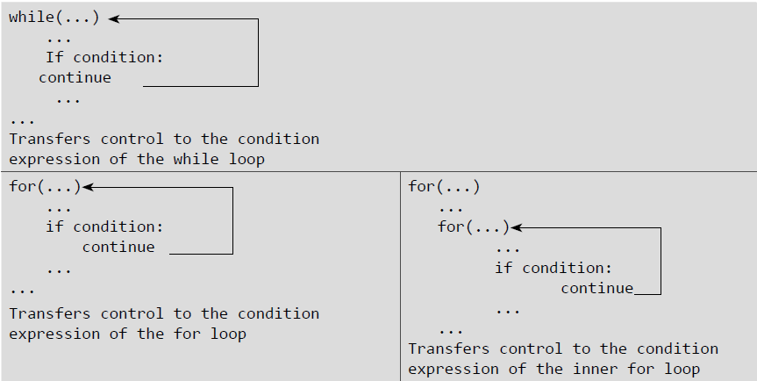
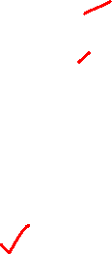
The Continue Statement
Like the break statement, the continue statement can only appear in the body of a loop. When the compiler encounters a continue statement then the rest of the statements in the loop are skipped and the control is unconditionally transferred to the loop-continuation portion of the nearest enclosing loop.
Example:

Slide 17
The Pass Statement
Pass statement is used when a statement is required syntactically but no command or code has to be executed. It specified a null operation or simply No Operation (NOP) statement. Nothing happens when the pass statement is executed.
Difference between comment and pass statements In Python programming, pass is a null statement. The difference between a comment and pass statement is that while the interpreter ignores a comment entirely, pass is not ignored. Comment is not executed but pass statement is executed but nothing happens.
Example:

Slide 18
The Else Statement Used With Loops
Unlike C and C++, in Python you can have the else statement associated with a loop statements. If the else statement is used with a for loop, the else statement is executed when the loop has completed iterating. But when used with the while loop, the else statement is executed when the condition becomes false.
Examples:

Slide 19
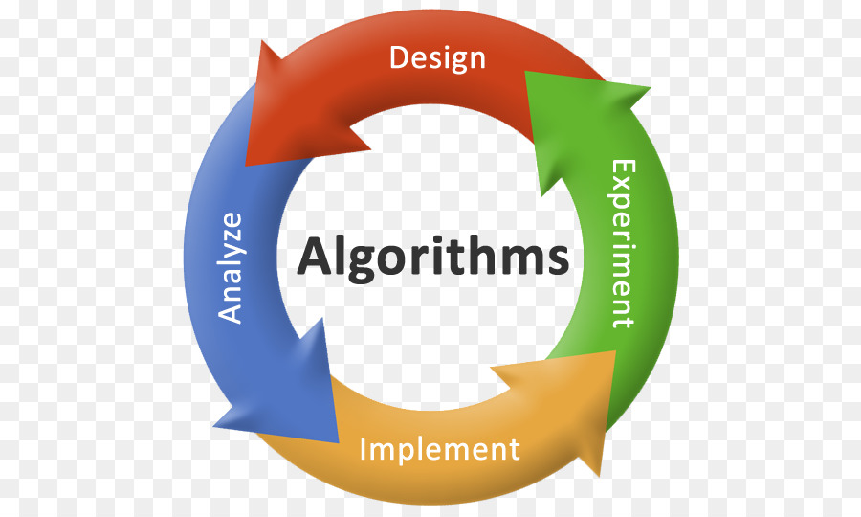
Algorithms
An algorithm is a set of rules that specify the order and kind of arithmetic operations that are used on a specified set of data.
An algorithm is an effective method expressed as a finite list of well-defined instructions for calculating a function.
An algorithm is a finite, definite, effective procedure, with some output
Systematic procedure that produces – in a finite number of steps –
the answer to a question or the solution of a problem.

Slide 20
Essential properties of an algorithm
an algorithm is finite (w.r.t.: set of instructions, use of resources, time of computation)
instructions are precise and computable
• instructions have a specified logical order, however, we can discriminate between
deterministic algorithms (every step has a well-defined successor)
non-deterministic algorithms (randomized algorithms, e.g.)

Slide 21
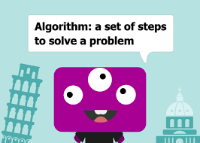
Basic Questions About Algorithms
For each algorithm, we should answer the following basic questions:
• does it terminate?
• is it correct?
• is the result of the algorithm determined?
• how much resources will it use in terms of
• memory? (and memory bandwidth?) • operations?
• run-time

Slide 22
Swapping Two Numbers Using Variable
In many case, programmers are required to swap values of two variables. Here, we shall learn how to swap values of two integer variables, that may lead to swapping of values of any type. Values between variables can be swapped in two ways −
With help of a third (temp) variable
Without using any temporary variable

Slide 23

Swapping Two Numbers Using Variable With help of a third (temp) variable
Logic:
Suppose we take two values in a and b, a=10, b=20 respectively.
temp=a;
a=b;
b=temp;
After the operation of this statement, the value of two variable a and b will be interchanged.
Output:
A=20, B=10;

Slide 24
Algorithm:
Using the temporary variable
Step 1: Start
Step 2: Take the value of variables a and b.
Step 3: Assign the value of variable a into the temp variable.
Step 4: Assign the value of variable b into a variable.
Step 5: Assign the value of variable temp into the b variable.
Step 6: Print the value of a and b.
Step 7: Stop

Slide 25
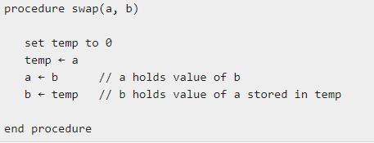
Pseudocode
Using the temporary variable

Slide 26
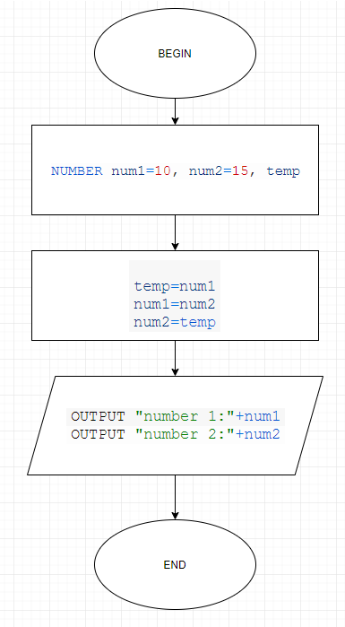
Flow Chart

Slide 27
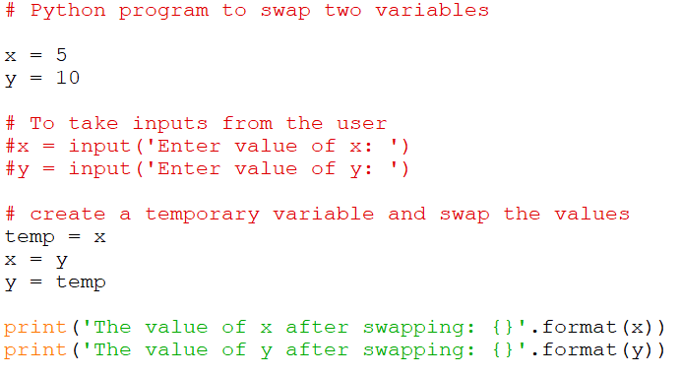
Python Program

Slide 28
Swapping Two Numbers without Using Variable
Here we will use arithmetic operator (+, -). We use addition and subtraction operation on these variables.
a=a+b;
b=a-b;
a=a-b;

Slide 29
Algorithm:
Without Using the temporary variable
Step 1: Start
Step 2: Take the value of variables a and b.
Step 3: Add the values of the a and b and assign it to the variable a.
Step 4: Subtract the values of a and b and assign it to the variable b. (Here the value of a is changed due to the step 3).
Step 5: Subtract the values of a and b and assign it to the variable a.
Step 6: Print the value of a and b.
Step 7: Stop

Slide 30
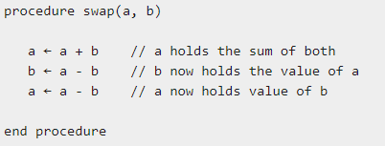
Pseudocode
Without Using the temporary variable

Slide 31
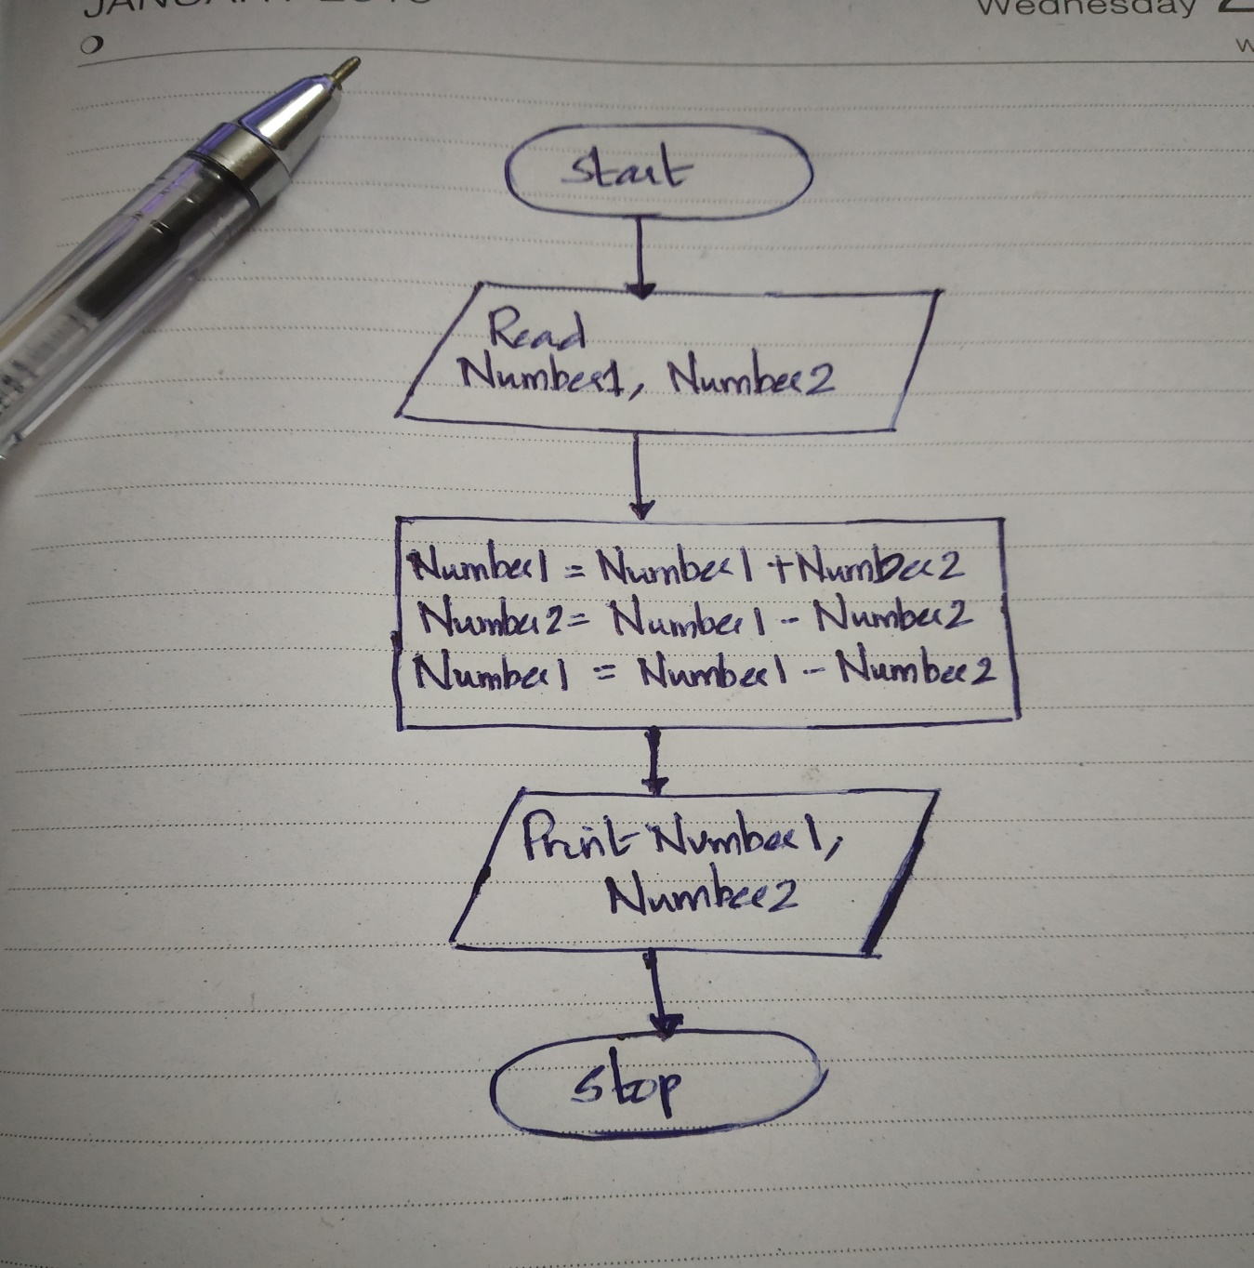
Flow Chart

Slide 32
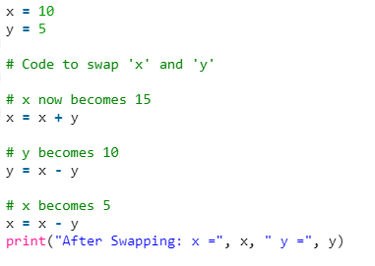
Python Program

Slide 33
Without using third variable and without using arithmetic operator
Here we will use the Exclusive OR bit-wise operator.
Logic:
a=a^b;
b=a^b;
a=a^b;

Slide 34
Algorithm:
Without Using the temporary variable
Step 1: Start
Step 2: Take the value of variables a and b.
Step 3: Operate Exclusive OR operation on variable a and b and assign the exclusive OR output in a variable. (Here value of a is changed)
Step 4: Operate Exclusive OR operation on variable a and b and assign the exclusive OR output in b variable. (Here value of b is changed)
Step 5: Operate Exclusive OR operation on variable a and b and assign the exclusive OR output in a variable. (Here value of a is again changed)
Step 6: Print the value of a and b.
Step 7: Stop

Slide 35
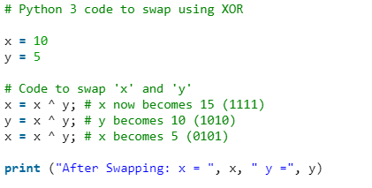
Python Program

Slide 36
Program to count digits in an integer
The integer entered by the user is stored in variable n. Then the while loop is iterated until the test expression n != 0 is evaluated to 0 (false).
After first iteration, the value of n will be 345 and the count is incremented to 1.
After second iteration, the value of n will be 34 and the count is incremented to 2.
After third iteration, the value of n will be 3 and the count is incremented to 3.
At the start of fourth iteration, the value of n will be 0 and the loop is terminated.

Slide 37
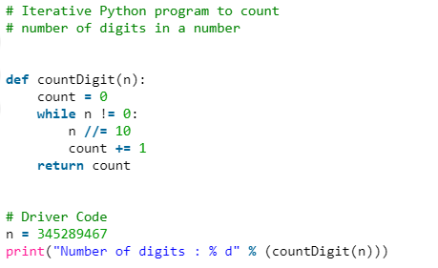
Program to count digits in an integer
Method 1

Slide 38
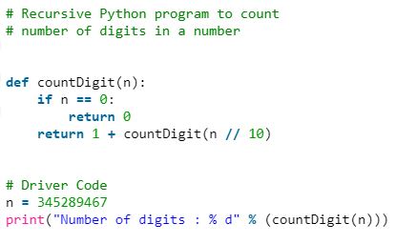
Program to count digits in an integer
Method 2

Slide 39
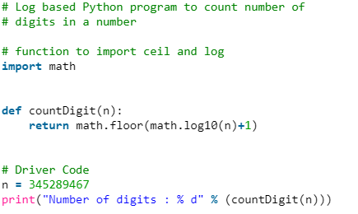
Program to count digits in an integer
Method 3

Slide 40
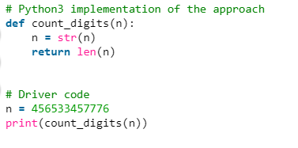
Program to count digits in an integer
Method 4

Slide 41
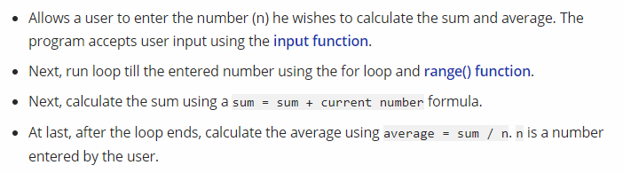
Algorithm: calculate the sum and average of first n natural numbers

Slide 42
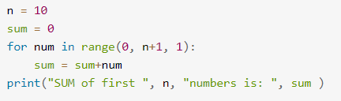
Python Program to calculate the Sum

Slide 43
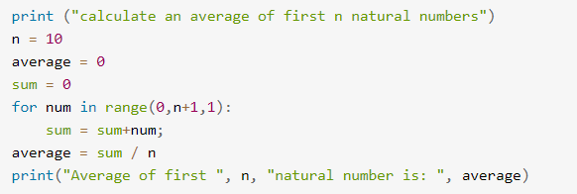
Python Program to calculate average

Slide 44
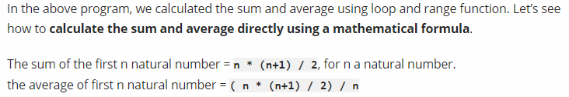
Calculate the sum and average of first n natural numbers using formula

Slide 45
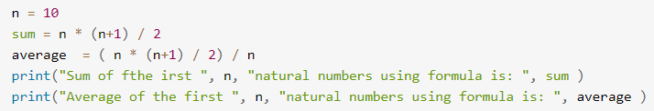
Calculate the sum and average of first n natural numbers using formula

Slide 46
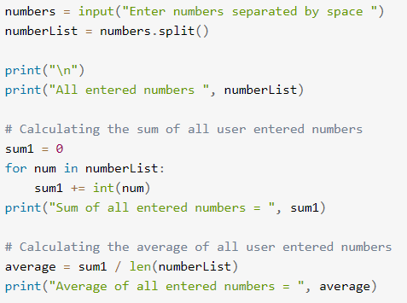
Calculate the sum and average of multiple user-entered numbers

Slide 47
Calculate the sum and average of multiple user-entered numbers

Slide 48
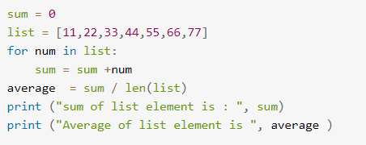
Calculate the sum and average of multiple user-entered numbers

Slide 49
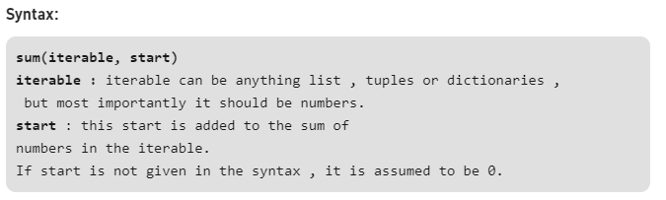
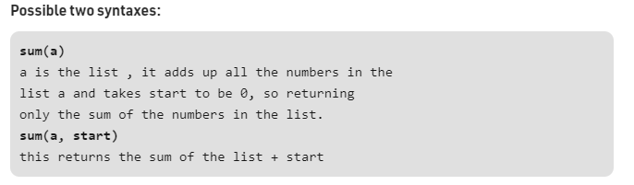
Calculate sum using the built-in sum function in Python
Sum of numbers in the list is required everywhere. Python provide an inbuilt function sum() which sums up the numbers in the list

Slide 50
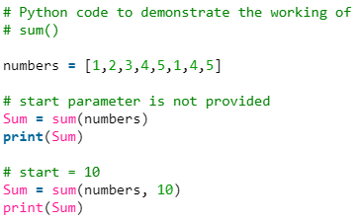
sum() function in Python

Slide 51
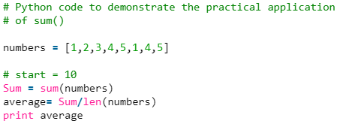
sum() function in Python
Practical Application: Problems where we require sum to be calculated to do further operations such as finding out the average of numbers.

Slide 52
Factorial Computation

Slide 53
Algorithm to calculate factorial value of a number
step 1. Start step 2. Read the number n step 3. [Initialize] i=1, fact=1 step 4. Repeat step 4 through 6 until i=n step 5. fact=fact*i step 6. i=i+1 step 7. Print fact step 8. Stop

Slide 54
Fibonacci Sequence

Slide 55
Algorithm to print Fibonacci series up to given number N
Step 1: Start
Step 2: Declare variables N, N1, N2, N3, i.
Step 3: Read value of N from user.
Step 4: if N < 2, display message “Enter number > 2” and go to step 9.
Step 5: Initialize variables N1 = 0, N2 = 1, i = 0
Step 6: Display N1, N2
Step 7: Compute N3 = N1 + N2
Step 8: Repeat following statements until i < N - 2
Display N3
N1 = N2
N2 = N3
N3 = N1 + N2
i = i + 1
Step 9: Stop

Slide 56
Reverse a Number

Slide 57
Algorithm to Reverse a Number
Step 1:Start
Step 2:Intilize reverse=0
Step 3:Read digit
Step 4:check whether digit>0 then go to step 5 else go to step 9
Step 5:reverse=reverse*10
Step 6:reverse=reverse+digit%10
Step 7:digit=digit/10
Step 8: Go to step 4
Step 9:Print reverse
Step 10: Stop

Slide 58
Base Conversion
Decimal to Any Base
Decimal to Octal
Decimal to Binary
Decimal to Hexadecimal
Binary to Any Base
Octal to any base
Hexadecimal to any base

Slide 59
The Basic Idea
The basic algorithm for this conversion is to repeatedly divide (integer division) the given decimal number by the target base value until the decimal number becomes 0.
The remainder in each case forms the digits of the number in the new base system, however, in the reverse order.

Slide 60
An Upper Limit
The algorithm, in general, will work for any base, but we need digits/characters to represent that many numbers of a base system.
For simplicity, we limit ourselves to base 36 i.e 10 numbers + 26 alphabets.
(We can differentiate lower and upper case, but we intend to focus on the algorithm here!).
It will be clear after the implementation that the method has to work for any base.

Slide 61
Decimal to Base_{x}
Divide the decimal number by the radix of the target base
The remainder from step 1 becomes the value for the current column.
Use the quotient (answer) from step 1 as the decimal value to calculate the next column.
Return to step 1 and repeat until the quotient is zero.

Slide 62
Example – Decimal to Binary
Let's return to the number 237 and convert it to a binary number:
decimal: |  | 237
radix: |  | 2
Decimal |  | Radix |  | Quotient |  | Remainder
237 | / | 2 |  | 118 |  | 1 (2⁰)
118 | / | 2 |  | 59 |  | 0 (2¹)
59 | / | 2 |  | 29 |  | 1 (2²)
29 | / | 2 |  | 14 |  | 1 (2³)
14 | / | 2 |  | 7 |  | 0 (2⁴)
7 | / | 2 |  | 3 |  | 1 (2⁵)
3 | / | 2 |  | 1 |  | 1 (2⁶)
1 | / | 2 |  | 0 |  | 1 (2⁷)
binary: |  | 11101101

Slide 63
Example – Decimal to Hexadecimal
decimal: |  | 3,134,243,038
radix: |  | 16
Decimal |  | Radix |  | Quotient |  | Remainder
3,134,243,038 | / | 16 |  | 195,890,189 |  | E (14) (16⁰)
195,890,189 | / | 16 |  | 12,243,136 |  | D (13) (16¹)
12,243,136 | / | 16 |  | 765,196 |  | 0 ( 0) (16²)
765,196 | / | 16 |  | 47,824 |  | C (12) (16³)
47,824 | / | 16 |  | 2,989 |  | 0 ( 0) (16⁴)
2,989 | / | 16 |  | 186 |  | D (13) (16⁵)
186 | / | 16 |  | 11 |  | A (10) (16⁶)
11 | / | 16 |  | 0 |  | B (11) (16⁷)
hexadecimal: |  | xBAD0C0DE

Slide 64
Decimal to Any Base – Python Implementation
def dec_to_base(num,base): #Maximum base - 36
base_num = ""
while num>0:
dig = int(num%base)
if dig<10:
base_num += str(dig)
else:
base_num += chr(ord('A')+dig-10) #Using uppercase letters
num //= base
base_num = base_num[::-1] #To reverse the string
return base_num

Slide 65
Base_{x} to Decimal
Actually, I have already demonstrated how to convert a number from a base different than ten, into decimal. Once again, here is the complete formula, where c_{x} represents the coefficients at each place-column.
c_{n}·b^{n} + ... + c₂·b² + c₁·b¹ + c₀·b⁰
As an example, let's convert the binary answer back into decimal:
1·2⁷ + 1·2⁶ + 1·2⁵ + 0·2⁴ + 1·2³ + 1·2² + 0·2¹ + 1·2⁰
1·128 + 1·64 + 1·32 + 0·16 + 1·8 + 1·4 + 0·2 + 1·1
128 + 64 + 32 + 8 + 4 + 1
237

Slide 66
Base_{x} to Base_{y}
Is it possible to convert a number from Base_{x} directly to Base_{y} without converting to decimal (base-10) first?
Yes, however, you will need to perform all of your math operations in either Base_{x} or Base_{y}. The algorithms that I have presented are performed with base-10 since that is the number system most people are familiar with.

